Slide 2

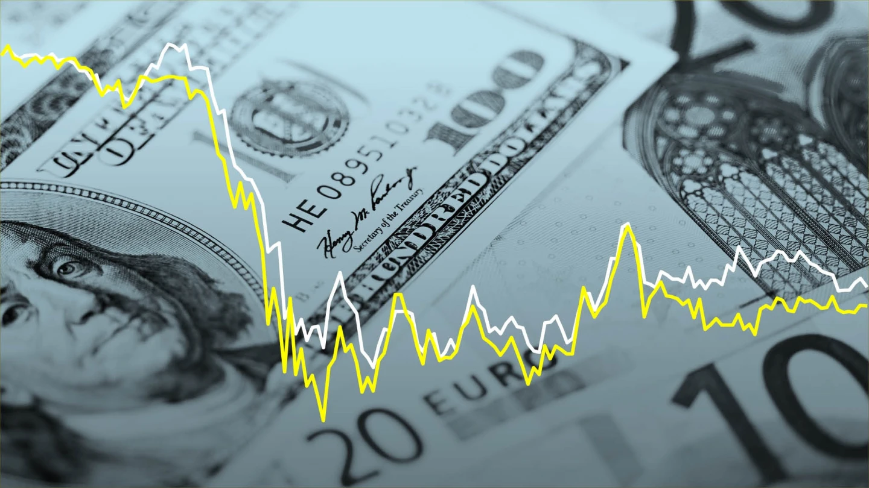
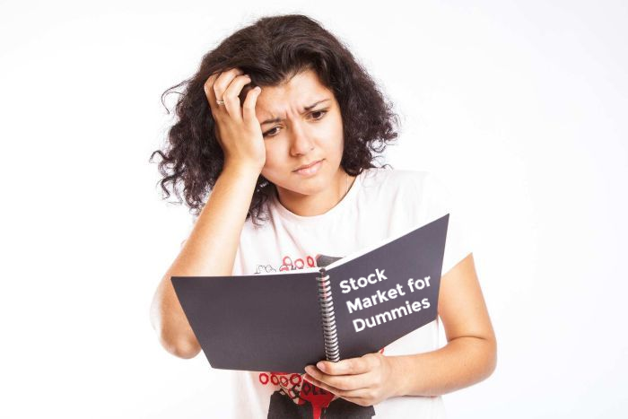



EVER INVESTED IN THE STOCK MARKET?
Notes:
Ever invested in the stock market?? Made too many losses following wallstreet bet threads?? Decided to read on trends and analysis on companies??
Does your portfolio look something like this? (SHOW THE HORROR!!!) Yes we are looking at you poor sad folks!!!

Slide 3

EVER INVESTED IN THE STOCK MARKET?
Notes:
Ever invested in the stock market?? Made too many losses following wallstreet bet threads?? Decided to read on trends and analysis on companies??
Does your portfolio look something like this? (SHOW THE HORROR!!!) Yes we are looking at you poor sad folks!!!

Slide 4

Notes:
I'm sure all of you are wondering, how can we play the game and predict stock movements accurately EVERY TIME?

Slide 5
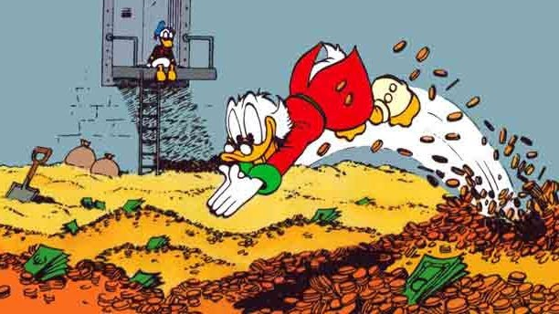


TECHNICAL ANALYSIS
FUNDAMENTAL ANALYSIS
YOU CAN’T
Notes:
Well, the truth is you <emphasis level="strong">can't</emphasis>. If anyone could do that, then <emphasis level="strong">all</emphasis> of us
would be <emphasis level="strong">rich!</emphasis>
<prosody pitch="high"> However, don't be disheartened.</prosody> We are here to explore and analyze stock market trends based on technical and fundamental analysis data are used by professional investors.
For all you novice investors, u might be wondering, what are these data?! Well, Fundamental data are quarterly data provided by companies which includes revenues, earnings,
profit margins, and other data, which allows us determine a company's underlying value and potential for future growth. Technical data on the other hand are the historical market data, including
price and volume. For our project, we will be focusing on enterprise values, ratios, financial growth and key metrics for the fundamental data to ensure attributes are linearly independent, and
for technical data, we will only be focusing on the closing prices for each day.

Slide 6

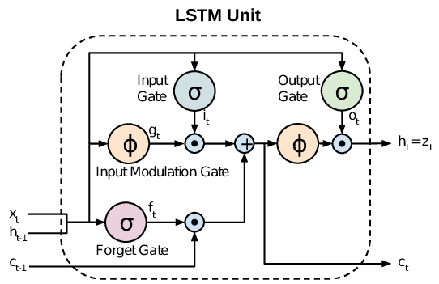
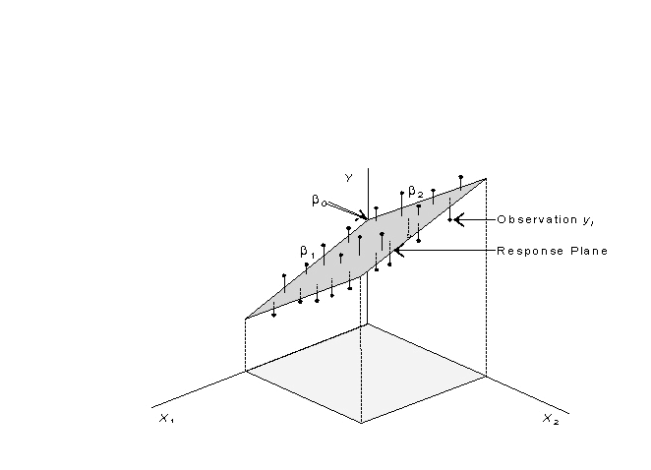
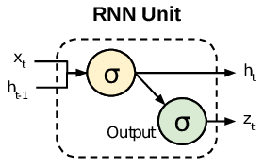
Time Series
Multi-linear Regression
Notes:
We want to <emphasis level="strong">explore</emphasis> the possibility of uncovering trends in the 1-month-later and 6-months-later closing prices. <break time="2s"/> This is done using 3 machine learning models: time series multi-linear regression <break time="1s"/>, long short term memory<break time="1s"/>, and recurrent neural network.

Slide 7
Firstly, time series multi-linear regression (MLR)
Notes:
Let’s explore the first model.

Slide 8
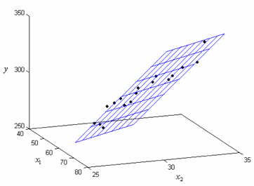



Timeseries MLR
TIME SERIES
MULTI-LINEAR REGRESSION
Stock Price
Notes:
Multi-linear regression is a statistical technique that uses explanatory variables to predict outcomes of a response variable.
To the initial list of features from fundamental data, we first added time features to determine if time has an effect on stock prices – hence the term time-series. Next, we obtain the “best-fit” multi-dimensional line representing our prediction. Finally, we select the most important features that minimise errors by repeating this process across companies.

Slide 9
Next, recurrent neural network (RNN)
Notes:
Let’s take a look at our second model, RNN

Slide 10

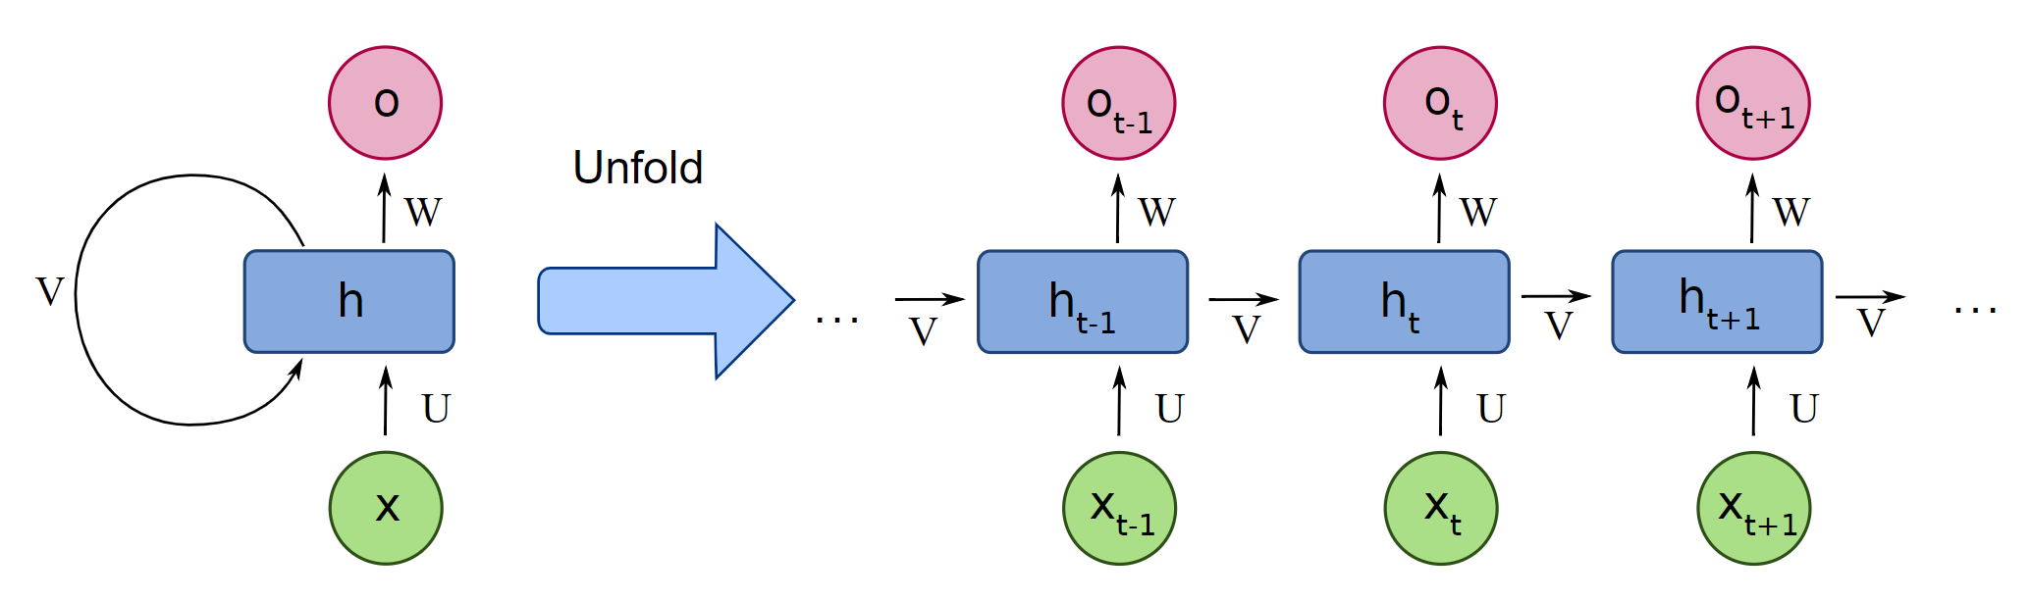

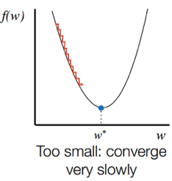
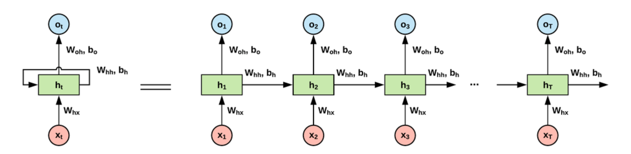
Notes:
RNN PLS TALK ABOUT VANISHING GRADIENT PROBLEM
RNN uses stored internal state to process input layers. At every time unit, new data points, which in our case, are 3D-input vectors of either 30 or 180 rows of data, are fed to the model. Past information and learned knowledge are then encoded in the network state vectors.
However, RNN suffers from the problem of vanishing gradients, where the gradients used to update the model parameters eventually goes to 0. Parameter updates become insignificant and no real learning is done, resulting in a model that underfits.

Slide 11
Lastly, long short term memory (LSTM)
Notes:
Let’s take a look at our final model, LSTM

Slide 12
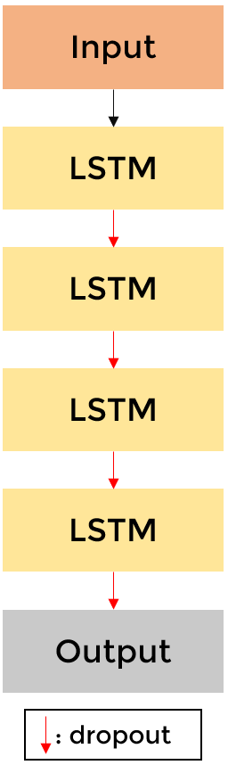
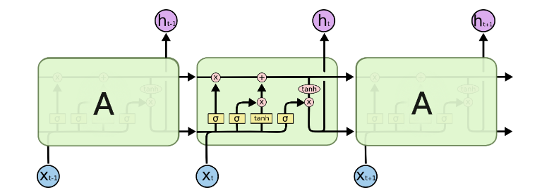


Cell state
RNN
LSTM
Input gates
Notes:
https://colah.github.io/posts/2015-08-Understanding-LSTMs/
LSTMs are able to deal with vanishing gradient and long-term dependency problems. The advantage of an LSTM cell compared to a common recurrent unit is its cell state. At every time unit, new data points are fed to the model, and the three gates decide which information from previous cell state to retain, and which to discard for new information.
This way, our model is able to retain informational trends of the data in each company based on their features, which are the fundamental and technical analysis data.

Slide 13

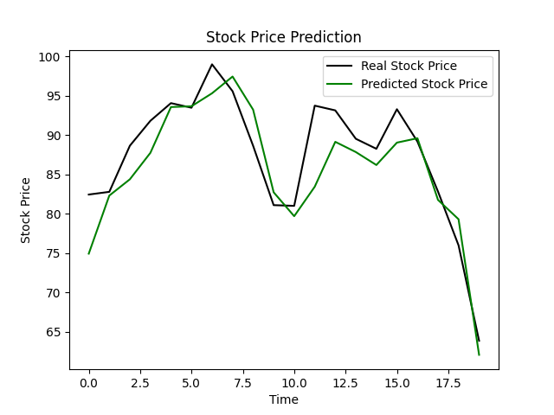
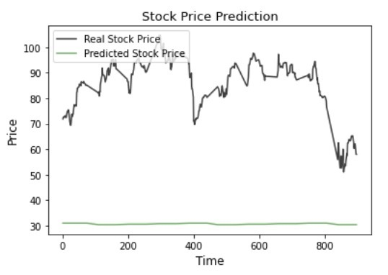
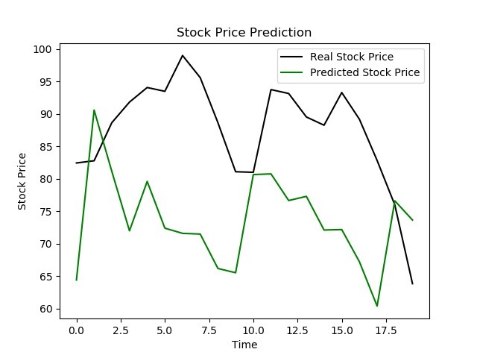
Model | Time series MLR | RNN | LSTM
1-month average RMSE | 44.18 | 47.02 | 8.03
6-months average RMSE | 81.62 | 49.83 | 13.45
1-month plots for CVGW
Notes:
Root mean squared error of the predicted closing price against the actual closing price 1 and 6-months ahead is used to determine which model performs the best, and they are reflected in the table. LSTM model outperforms the other models by a large margin and predicts relatively well.

Slide 14
Model | Time series MLR | RNN | LSTM
1-month average RMSE | 44.18 | 47.02 | 8.03
6-months average RMSE | 81.62 | 49.83 | 13.45
1-month plots for CVGW
Notes:
Root mean squared error of the predicted closing price against the actual closing price 1 and 6-months ahead is used to determine which model performs the best, and they are reflected in the table. LSTM model outperforms the other models by a large margin and predicts relatively well.

Slide 15





LSTM
DISCLAIMER!
RNN
MLR
*We will not be liable for any loss of money.
Notes:
In conclusion, LSTM predicts with the least cost amongst the 3 models. However, this is highly dependent on how much data is fed to the model. While LSTM predicts well for some companies, it may not do so for others. This looks promising, but please do not use this model to invest. We will not be liable for any loss of money.

Slide 16
Credits
Image of r/wallstreetbets from https://www.benzinga.com/fintech/20/06/16212973/wallstreetbets-pivots-to-online-trading-competition-targeting-millennials-zoomers
Image of confused person from https://gavinduffyandassociates.com/prevent-your-audience-from-zoning-out/confused-person/
Image of “I want you” from https://rokerreport.sbnation.com/2016/6/14/11931570/writers-vacancies-we-want-you
Image of Scrooge from https://electricliterature.com/the-ten-ways-your-life-will-change-after-you-publish-your-first-book-or-so-im-told/
Images of stock markets from https://www.fool.com/investing/2019/01/09/what-happened-in-the-stock-market-today.aspx, https://www.fool.com/investing/2020/03/12/should-i-sell-my-stocks-due-to-coronavirus.aspx, https://medium.com/the-domino/how-the-2020-economic-collapse-will-differ-from-the-2008-financial-crisis-d0f5b5b1b49b
Image of confused person investing from https://www.stockinvestor.com/47101/how-to-never-lose-money-again-in-the-stock-market/
Image of MLR from https://towardsdatascience.com/multiple-linear-regression-beginners-guide-5b602d716aa3
Image of RNN, LSTM from https://stats.stackexchange.com/questions/222584/difference-between-feedback-rnn-and-lstm-gru
Image of LSTM from https://colah.github.io/posts/2015-08-Understanding-LSTMs/
Icons made by Freepik: https://www.flaticon.com/authors/freepik from www.flaticon.com

